Slide 1

SARDAR VALLABHBHAI NATIONAL INSTITUTE OF TECHNOLOGY
Digital Communication Lab
Exp. No. 11
Quadrature Amplitude Modulation
(QAM)

Slide 2
Experiment No.11
To examine the 16-QAM (Quadrature Amplitude Modulation) and demodulation scheme. Draw the 16-QAM m-array mapped signal and modulated waveform. Evaluate BER values for it by using MATLAB Code.

Slide 3
Quadrature amplitude modulation or QAM is widely used for modulating data signals onto a carrier used for radio communications.
Two carriers shifted in phase by 90° are modulated & the resultant output consists of both amplitude & phase variations.
It may also be considered as a mixture of amplitude and phase modulation. QAM is both an analog and digital modulation technique.

Slide 4
TYPES OF QAM
A variety of forms of QAM are available which include
16 QAM,
32 QAM,
64 QAM,
128 QAM, &
256 QAM.

Slide 5
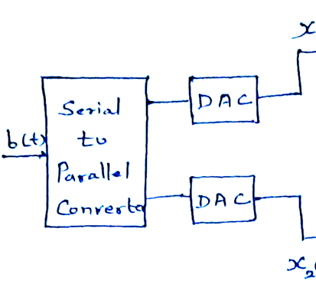
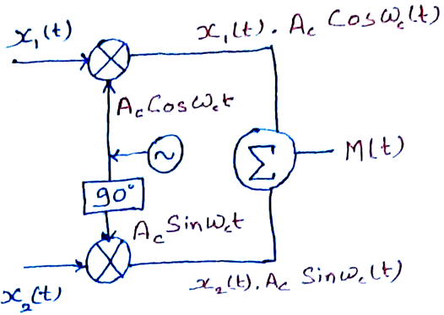
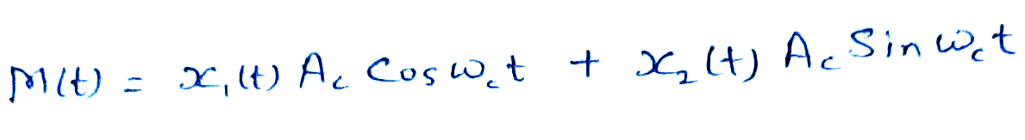
Transmitter of QAM

Slide 6
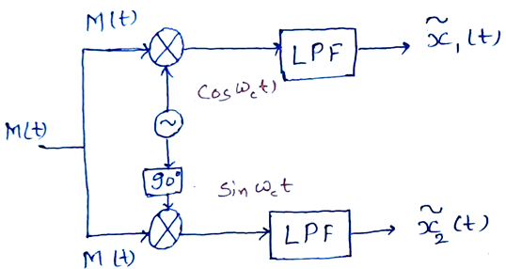
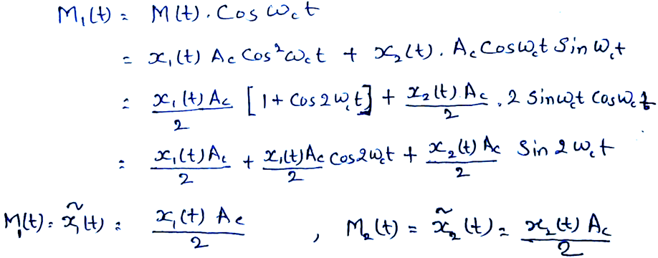
Receiver of QAM

Slide 7
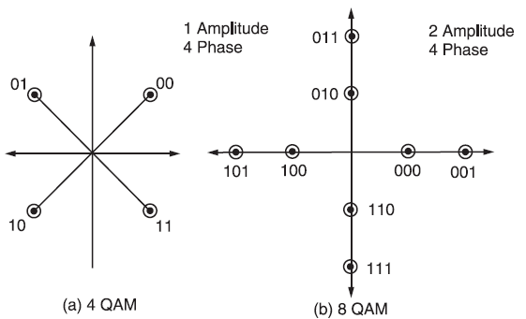
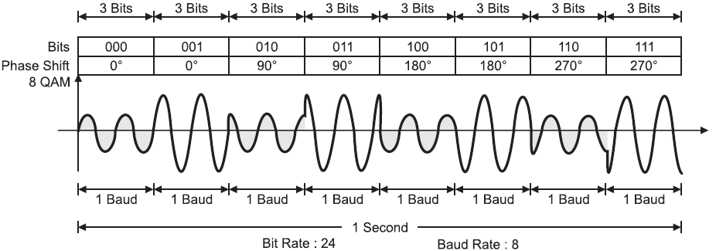

Slide 8
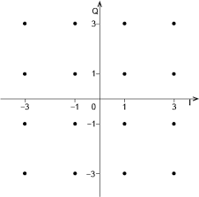
Constellation diagram of 16-QAM

Slide 9
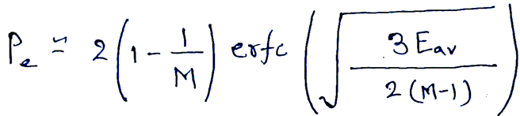
Bit Error Rate (Received Bit)
While higher order modulation rates are able to offer much faster data rates and higher levels of spectral efficiency for the radio communications system, this comes at a price.
The higher order modulation schemes are considerably less resilient to noise and interference.
Many radio communications systems now use dynamic adaptive modulation techniques. They sense the channel conditions and adapt the modulation scheme to obtain the highest data rate for the given conditions.
M-QAM technique provide better bit error rate performance than M-PSK modulation techniques.

Slide 11
Advantages
The advantage of using QAM is that it is a higher order form of modulation. As a result it is able to carry more bits of information per symbol.
By selecting a higher order format of QAM, the data rate of a link can be increased.
Bit rate is increased without increasing the bandwidth

